Slide 1

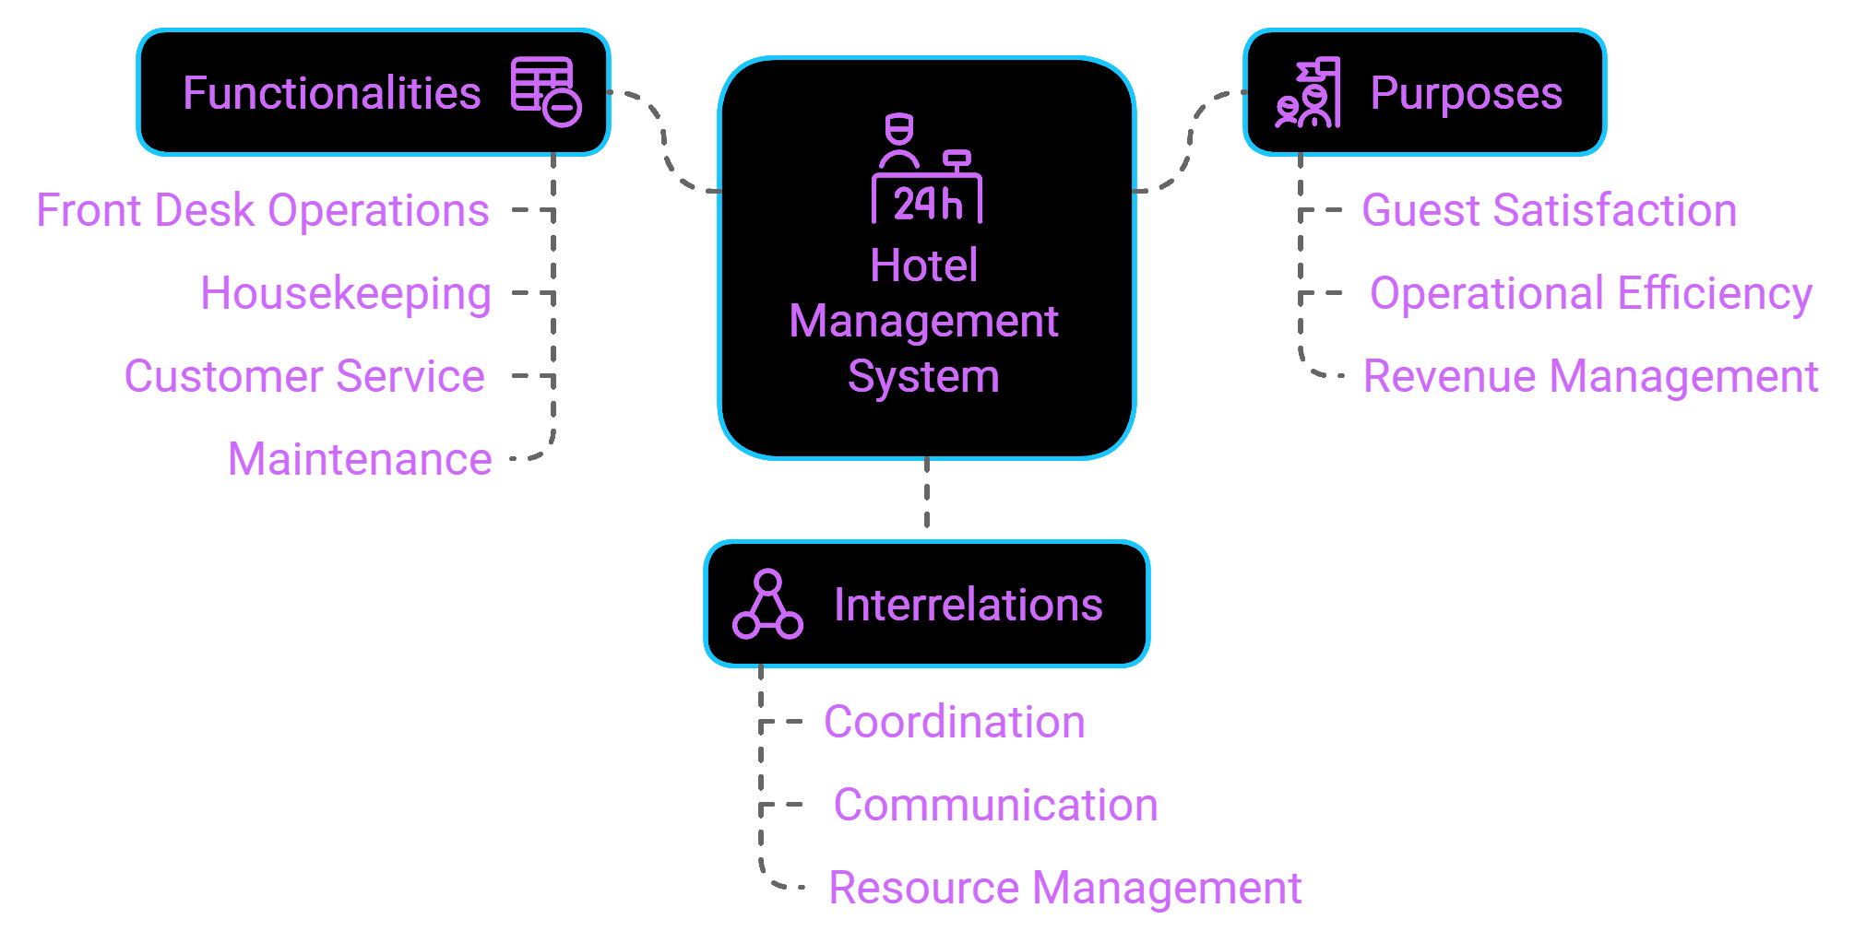
Hotel management system
Hotels have different functionalities
Each has its own purpose
Each of the functions relate to each other

Slide 2
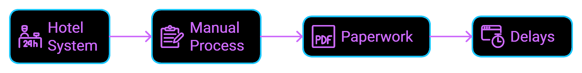
Hotel management system
The hotel system is usually a manual system, mostly depends on paperwork
•Delay
•Data inaccuracy
•More expensive (use more manpower)
•Etc.…

Slide 3
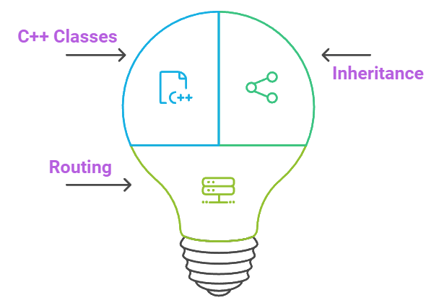
Hotel management system
Proposed system:
HotelMatrix:
A new proposed system.
based on C++ classes inheritance and routing.
with each classes relating/depending on each other).

Slide 4
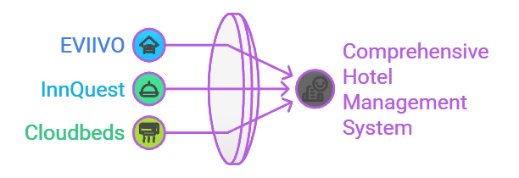
Hotel management system
Similar systems:
•EVIIVO
reservations, payments, and guest interactions
•InnQuest
property management system, booking engine, OTA channels
•Cloudbeds
property management system, booking engine, OTA channels

Slide 5
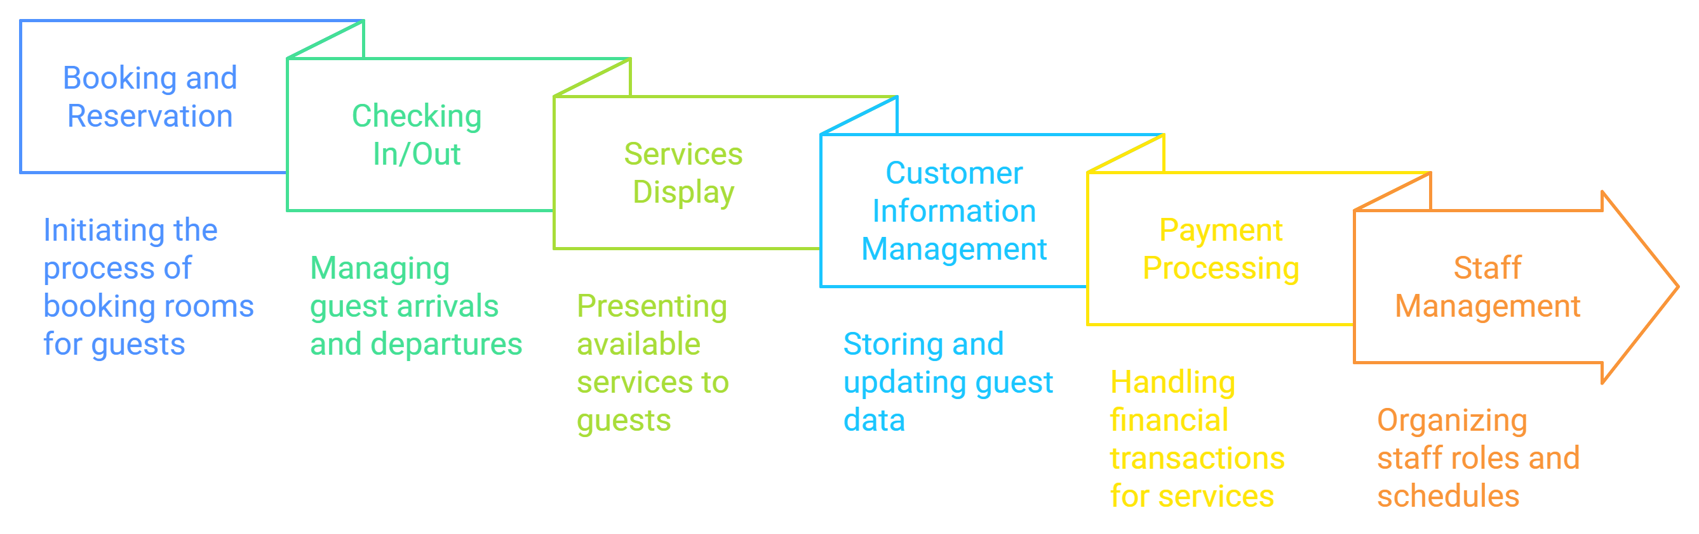
Hotel management system
Functionalities:

Slide 6
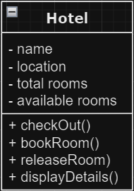
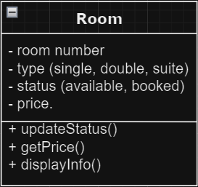
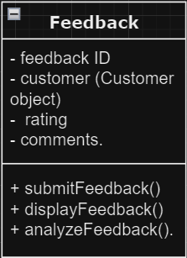
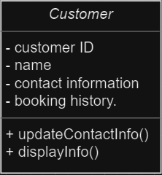
Hotel management system
Classes:

Slide 7
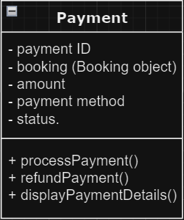
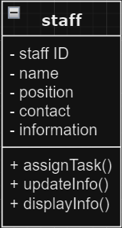
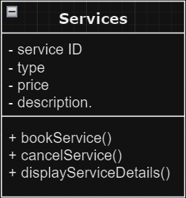
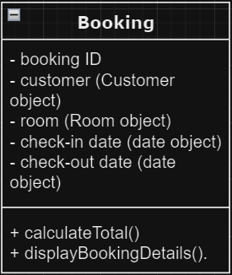
Hotel management system
Classes:

